Slide 1

Getting Started: An Overview of Databases
DAVID M. KROENKE and DAVID J. AUER
DATABASE CONCEPTS, 7th Edition, Global Edition
Chapter One

Slide 2
Chapter Objectives
Identify the purpose and scope of this book
Know the potential problems with lists
Understand the reasons for using a database
Understand how using related tables helps you avoid the problems of using lists
Know the components of a database system
Learn the elements of a database
Learn the purpose of the database management system (DBMS)
Understand the functions of a database application
Introduce non-relational databases

Slide 3
Purpose of a Database
The purpose of a database is to keep track of things.
Unlike a list or spreadsheet, a database may store information that is more complicated than a simple list.
Notes:
keep track of 1.…을 기록하다 2.…의 자국을 뒤밟다 3.…을 놓치지 않도록 하다; 끊임없이 …의 정보를 얻어내다
thing [¨i¤] n. 1 (유형의) 물건, 물체, 무생물체. a ∼ and its properties 물체와 그 속성. Guns are deadly ∼s. 총은 목숨을 빼앗는 물건이다. There is a name for every ∼. 물건에는 모두 이름이 있다. 2 추상적인[무형의] 것; <∼s> <형용사 앞에서> <종종 익살> (생각의 대상으로서의) 물(物), 사물, 사항; 문제(점). all ∼s 만물, 삼라 만상. ∼s Korean 한국적인 사물, 한국의 풍물. ∼s musical 음악에 관한 사항. the ∼ we disagree over 의견이 맞지 않는 문제. several ∼s to attend to 유의해야 할 몇 가지 점. That type of criticism is quite a ∼ of the past. 그런 종류의 비평은 이제는 완전히 과거의 것이 되어버렸다. 3 생각, 의견; 한 마디 말; 주장, 논제. say the right ∼ 마땅한[그 자리에 알맞은] 말을 하다. 4 행위(deed); 일, 잡일; 사건. do great ∼s 위대한 일을 해내다. I've got a lot of ∼s to do today. 오늘은 해야 할 일이 많다. 5 <∼s> (종합적인) 상태, 상황, 정세, 형편. as ∼s are[stand] 현 상태에서는. as ∼s go 지금 상태로는; 세상사가 그렇듯이. take ∼s easy 사태를 낙관하다. Things are getting better. 사태가 호전되고 있다. How are ∼s with you? 어떻게 지내나?

Slide 4
Problems with Lists: Redundancy
In a list, each row is intended to stand on its own. As a result, the same information may be entered several times.
For Example: A list of Projects may include the Project Manager’s Name, ID, and Phone Extension.
If a particular person is managing 10 projects, his/her information would have to be entered 10 times.
Notes:
- on one's own 1. 혼자서, 단독으로(alone) 2. 자력으로, 자기 책임 아래; 독립해서 3. 훌륭한, 현저한
- 문제는 Project Manager 정보의 (Name, ID, Phone Extension) 중에서, 꼭 필요한 ID 외에 다른 정보가 띠의 행에 같이 있다는 점이다. 이것이 정보 관리 문제를 유발한다.

Slide 5
Problems with Lists: Redundancy
Notes:
Redundancy 문제는 고객 정보 중에서, 꼭 필요한 Cust_Code 외에 다른 정보가 띠의 행에 같이 있다는 점이다. 이것이 정보 관리 문제를 유발한다.
자전거 스포크(바퀴살) 리플렉터 (야간 반사)

Slide 6
Problems with Lists: Multiple Themes
In a list, each row may contain information on more than one theme
As a result, needed information may appear in the lists
only if information on other themes is also present.
For Example: A list of Projects may include Project Manager information (Name, ID, and Phone Extension) and
Project information (Name, ID, StartDate, Budget) in the same row.
Notes:
글쓰기에서 주제라는 용어는 두 가지 의미로 쓰인다. 단순하게 화제(topic)라는 의미로도 쓰이고 요점(main point, gist)이라는 의미로도 쓰인다. 화제는 당신이 말하고 있는 내용에 관한 논점이나 제목이다. 당신이 무엇에 대해서 말하고 있다면 그 ‘무엇’이 화제다. 화제는 당신이 관심을 가지고 다루려고 하는 문제이기도 하다. 요점은 당신이 독자에게 전달하려는 정보를 요약한 것이다. 당신이 무엇에 대해서 말한다는 건, 좀더 자세히 보자면 무엇에 대해서 여러 정보를 말하는 것이다. 그런 정보들을 요약한 것이 요점이다. 정리하면, 주제는 화제나 요점이고, 달리 표현하자면 중심 문제나 중심 정보다. [서흥식, 주제의 두 의미: 주제는 화제나 요점이다, https://blog.naver.com/chiga/220188304745]
Remember your eighth-grade English teacher? He or she said that a paragraph should have a single theme. If you have a paragraph with more than one theme, you need to break it up into two or more paragraphs, each with a single theme. That idea is the foundation of the design of relational databases. A relational database contains a collection of separate tables.
A table holds data about one and only one theme in most circumstances. If a table has two or more themes, we break it up into two or more tables.
- 문제는 Project Manager 정보의 (Name, ID, Phone Extension) 중에서, 꼭 필요한 ID 외에 다른 정보가 띠의 행에 같이 있다는 점이다. (의존성 발생) 이것이 정보 관리 문제를 유발한다. (Project information에 대한 정보에 대해서도 마찬가지이다. )

Slide 7
List Modification Issues
Redundancy and multiple themes create modification problems:
Deletion problems
Update problems
Insertion problems
Notes:
Modification 調整 조정 - 고르지 못한 것이나 과부족(過不足)이 있는 것 따위를 알맞게 조절(調節)하여 정상(正常) 상태(狀態)가 되게 함

Slide 8
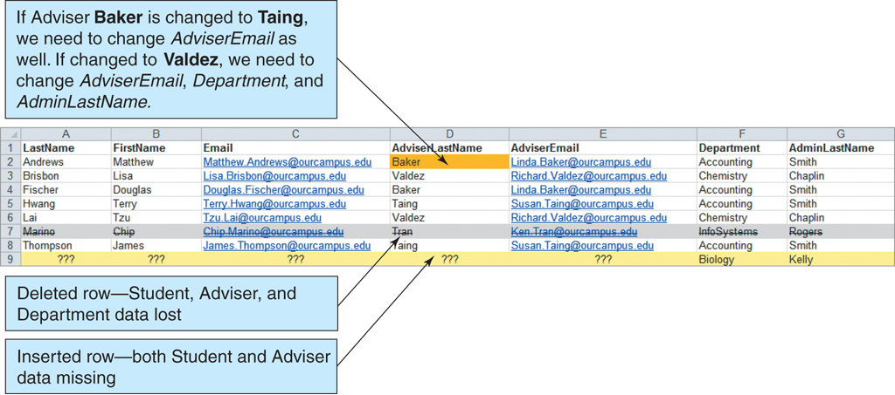
List Modification Issues (Cont’d)
Figure 1-5: The Student with Adviser and Department List
Notes:
Department Administrator 과사무장

Slide 9
Addressing Information Complexities
Relational databases are designed to address many of the information complexity issues.
Notes:
4. 〔일·문제 따위〕에 본격적으로 착수하다, 대처하다; 〔의제 따위〕를 검토[토의]하다. address the plan seriously 그 계획을 진지하게 검토하다.
4.<사물에> 초점을 맞추다; <어려운 문제 등을> 다루다, 처리하다, (본격적으로) 착수하다
5. a. To direct the efforts or attention of (oneself): address oneself to a task. b. To deal with: addressed the issue of absenteeism.

Slide 10
Relational Databases
A relational database stores information in tables. Each informational topic is stored in its own table.
In essence, a relational database will break-up a list into several parts—one part for each theme in the list.
A Project List would be divided into a CUSTOMER Table, a PROJECT Table, and a PROJECT_MANAGER Table.

Slide 11
Putting the Pieces Back Together
In our relational database, we broke our list into several tables.
Somehow the tables must be joined back together.
In a relational database, tables are joined together using the value of the data.
(1-13) Figure 1-6: The Adviser and Student Tables
If a PROJECT has a CUSTOMER, the Customer_ID is stored as a column in the PROJECT table.
The value stored in this column can be used to retrieve specific customer information from the CUSTOMER table.

Slide 12
Sounds Like More Work, Not Less
A relational database is more complicated than a list.
However, a relational database minimizes data redundancy, preserves complex relationships among topics, and allows for partial data.
Furthermore, a relational database provides a solid foundation for user forms and reports.

Slide 13
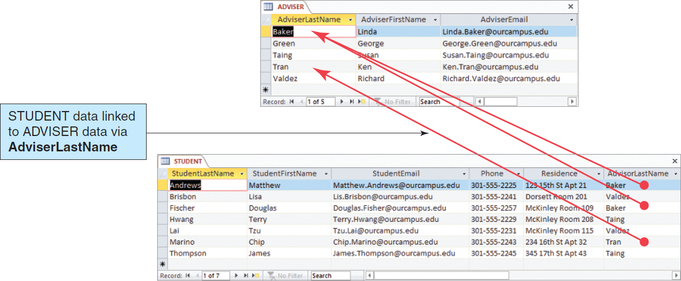
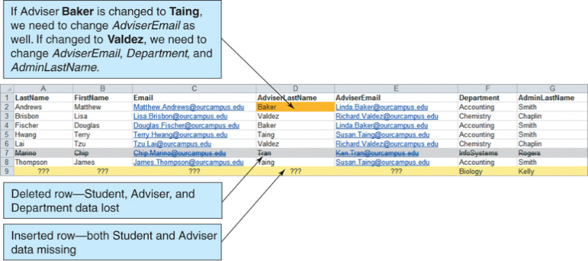
Relational Database Example
Figure 1-6: The Adviser and Student Tables

Slide 14
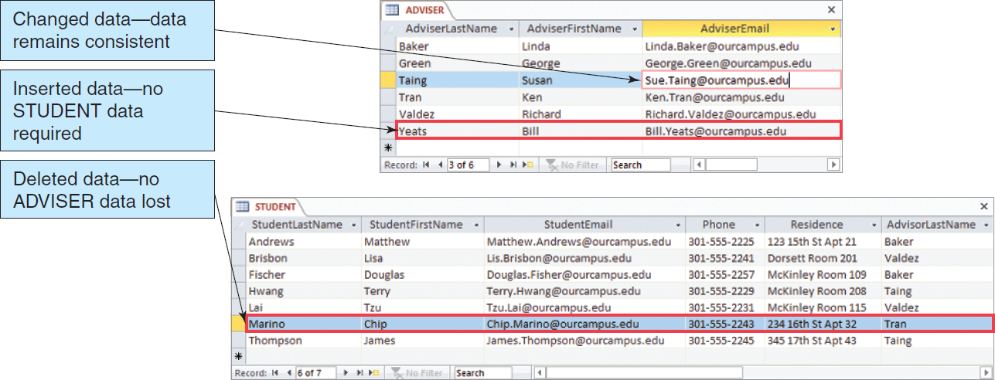
A Relational Database Solves the Problems of Lists
Figure 1-7: Modifying the Adviser and Student Tables
Notes:
Similarly, updating a value in this list can have unintended consequences. If, for example, you change AdviserEmail in the eighth row, you will have inconsistent data.
After the change, the fifth row indicates one email address for Professor Taing, and the eighth row indicates a different email address for the same professor.

Slide 15
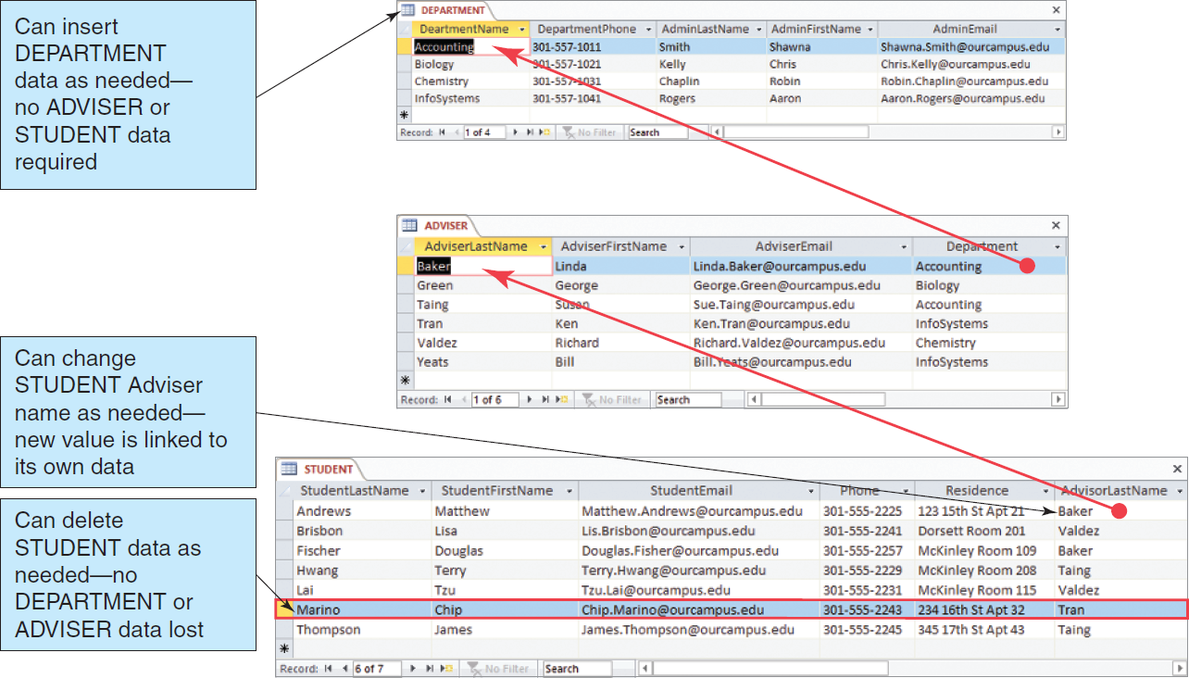
The Department, Advisor and Student Tables
Figure 1-8: The Department, Adviser, and Student Tables
Notes:
Department Administrator 과사무장

Slide 16
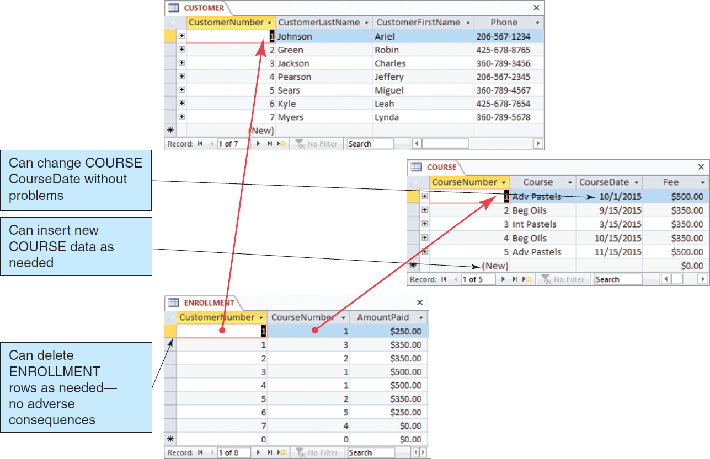
The Art Course Database Tables
Figure 1-10: The Art Course Database Tables
Notes:
Advanced Pastels (Adv Pastels) Course
Intermediate Pastels (Int Pastels) Course
Beginner’s Oils (Beg Oils) Course

Slide 17
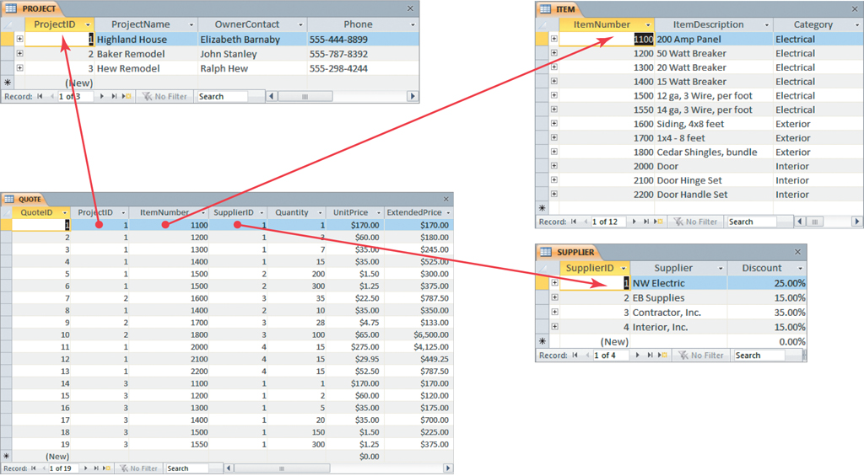
The Project Equipment Tables
Figure 1-12: The Project Equipment Database Tables

Slide 18
Structured Query Language (SQL)
Structured Query Language (SQL) is an international standard for creating, processing and querying databases and their tables.
Many database applications use SQL to retrieve, format, report, insert, delete, and/or modify data for users.
Notes:
Query [ˈkwɪəri] 1. 질의, 문의, 의문(question); 의심(doubt). 2. (불확실한 사항에 붙이는) 물음표. 3. 묻노니, 묻건대, 어때((질문의 첫머리에 두는 말, 보통 q., qu., qy라 줄여 씀)). Query, was the money ever paid? 어때 돈은 치렀는가?

Slide 19
SQL Example
We can use SQL to combine the data in the three tables in the Art Course Database to recreate the original list structure of the data.
We do this by using an SQL SELECT statement.

Slide 20
SQL Example (Cont’d)
SELECT CUSTOMER.CustomerLastName,
CUSTOMER.CustomerFirstName,
CUSTOMER.Phone,
COURSE.CourseDate, ENROLLMENT.AmountPaid,
COURSE.Course, COURSE.Fee
FROM CUSTOMER, ENROLLMENT, COURSE
WHERE CUSTOMER.CustomerNumber
= ENROLLMENT.CustomerNumber
AND COURSE.CourseNumber
= ENROLLMENT.CourseNumber;

Slide 21
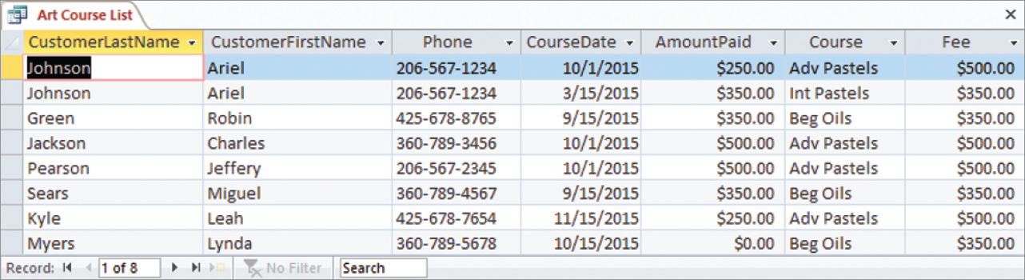
SQL Example Results
Figure 1-13: Results of the SQL Query to Recreate the Art Course List

Slide 22
Database Systems
The four components of a database system are:
Users
Database Application
Database Management System (DBMS)
DBMS ⊆ Database System
Database
Notes:
DBMS ⊆ Database System

Slide 23
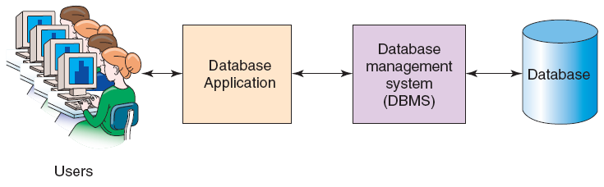
Components of a Database System
Figure 1-15: Components of a Database System
(DBMS ⊆ Database System)

Slide 24
Users
A user of a database system will
use a database application to track things;
use forms to enter, read, delete and query data; and
produce reports.

Slide 25
The Database
A database is a self-describing collection of related records.
The database itself contains the definition of its structure.
Metadata is data describing the structure of the database data.
Tables within a relational database are related to each other.

Slide 26
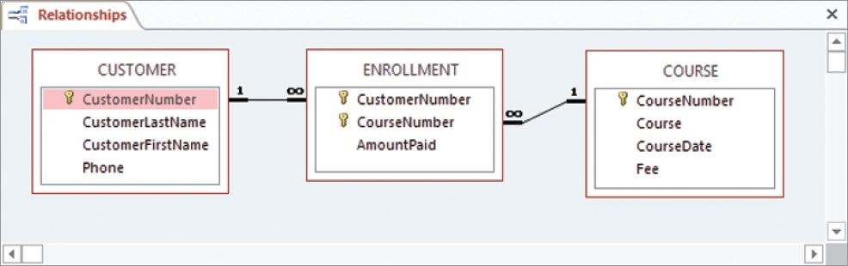
Example Database Metadata: A Relationship Diagram
Figure 1:16 Example Metadata: A Relationship Diagram for
the Art Course Tables in Figure 1-10

Slide 27
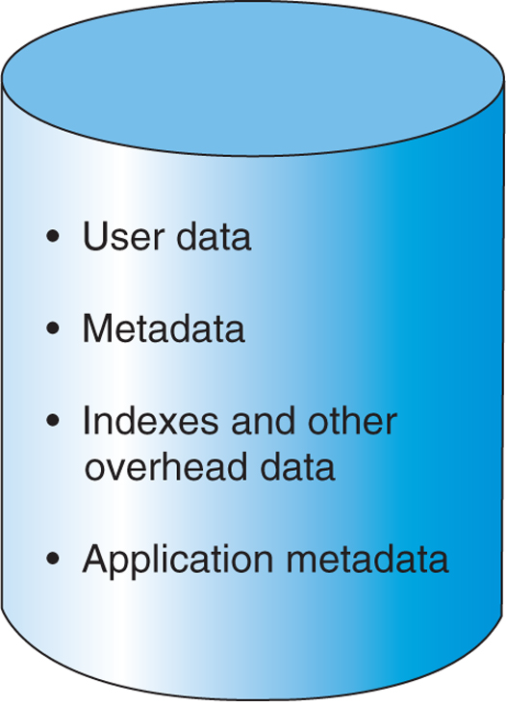
Database Contents
Figure 1-17 Database Contents
Notes:
A database also has indexes and other structures that exist to improve database performance, and we will discuss such structures in later chapters. Finally, some databases contain application metadata; these are data that describe application elements, such as forms and reports. For example, Microsoft Access carries application metadata as part of its databases.

Slide 28
Database Management System (DBMS)
A database management system (DBMS) serves as an intermediary between database applications and the database.
The DBMS manages and controls database activities.
The DBMS creates, processes and administers the databases it controls.

Slide 29
Functions of a DBMS
Create databases
Create tables
Create supporting structures
Read database data
Modify database data (insert, update, and delete)
Maintain database structures
Enforce rules
Control concurrency
Provide security
Perform backup and recovery
Notes:
To improve performance, we can create an index (akin to the index at the back of a book) for DepartmentName to show which employees are in which departments. Such an index
is an example of a supporting structure that is created and maintained by a DBMS.
Another DBMS function is to maintain all the database structures. For example, from time to time it might be necessary to change the format of a table or another supporting structure. Developers use a DBMS to make such changes.
With most DBMS products, it is possible to declare rules about data values and have a DBMS enforce them. For example, in the Art Course database tables in Figure 1-10, what would happen if a user mistakenly entered a value of 9 for CustomerID in the ENROLLMENT table? No such customer exists, so such a value would cause numerous errors. To prevent this situation, it is possible to tell the DBMS that any value of CustomerID in the ENROLLMENT table must already be a value of CustomerID in the CUSTOMER table. If no such value exists, the insert or update request should be disallowed. The DBMS then enforces these rules, which are called referential integrity constraints.

Slide 30
Referential Integrity Constraints
The DBMS will enforce many constraints .
Referential integrity constraints ensure that the values of a column in one table are valid based on the values in another table.
If a 5 was entered as a CustomerID in the PROJECT table, a Customer having a CustomerID value of 5 must exist in the CUSTOMER table.
Notes:
integrity [intégreti] n. 1 정직, 성실, 고결, 청렴(honesty) ð HONOR[동의어]. a person of high ∼ 뛰어나게 성실한 사람(▷ 종종 인물 소개에 쓰임). 2 완전한 상태, 무결(성)(entirety); 본래의 상태, 흠없는 상태(soundness). territorial ∼ 영토보전. in its ∼ 고스란히 그대로, 원래대로.

Slide 31
Database Applications
A database application is a set of one or more computer programs that serves as an intermediary between the user and the DBMS.

Slide 32
Functions of Database Applications
Create and process forms
Process user queries
Create and process reports
Execute application logic
Control database applications
Notes:
In addition to generating forms, queries, and reports, the application program takes other actions to update the database in accordance with application-specific logic. For example, suppose a user using an order entry application requests 10 units of a particular item. Suppose further that when the application program queries the database (via the DBMS) it finds that only eight units are in stock. What should happen? It depends on the logic of that particular application.
Finally, the last function of application programs listed in Figure 1-21 is to control the application. This is done in two ways. First, the application needs to be written so that only logical options are presented to the user. For example, the application may generate a menu with user choices. In this case, the application needs to ensure that only appropriate choices are available. Second, the application needs to control data activities with the DBMS. The application might direct the DBMS, for example, to make a certain set of data changes as a unit. The application might tell the DBMS to either make all these changes or none of them. You will learn about such control topics in Chapter 6.

Slide 33
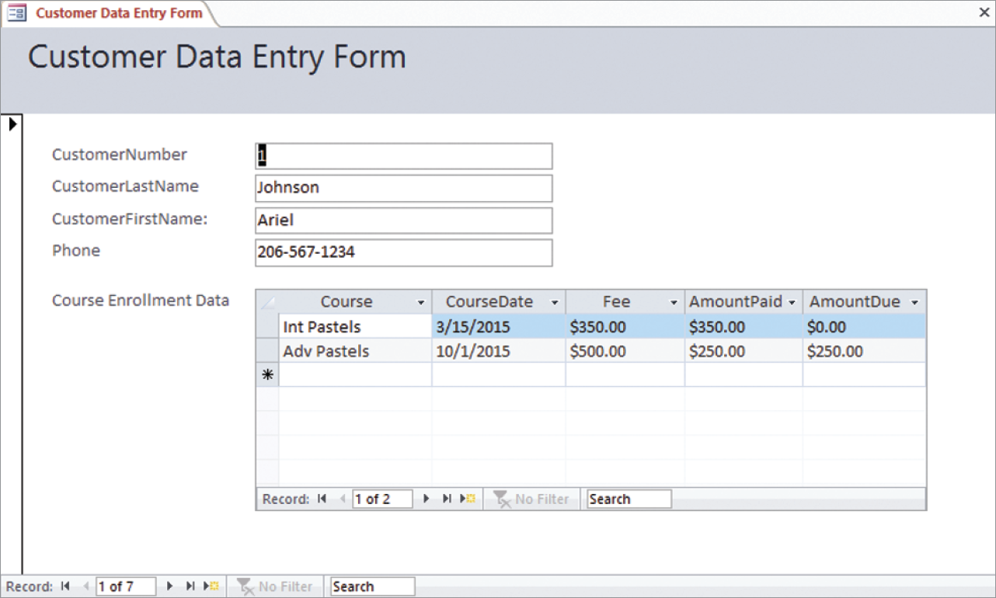
Database Applications: Example Data Entry Form
Figure 1-20: Example Data Entry Form

Slide 34
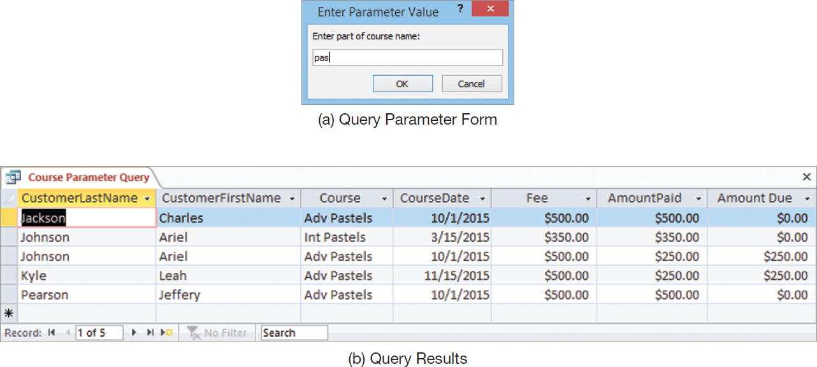
Database Applications: Example Query
Figure 1-21: Example Query

Slide 35
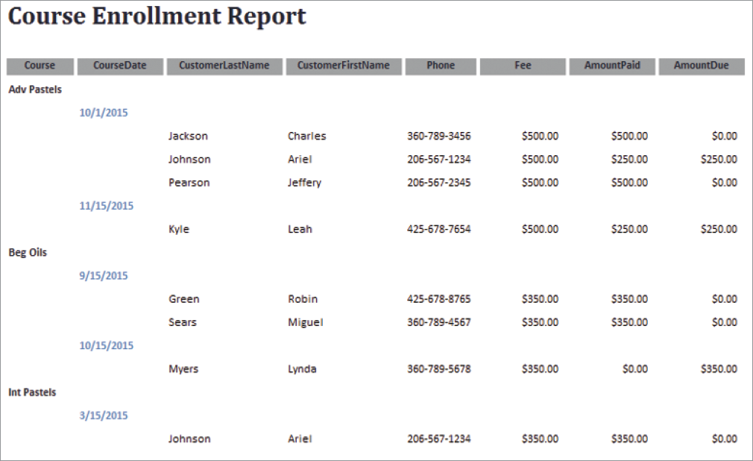
Database Applications: Example Report
Figure 1-22: Example Report

Slide 36
Personal Database Systems
Personal database systems typically
have one application.
A database application (cf. 1-31)
have only a few tables.
are simple in design.
involve only one computer.
support one user at a time.

Slide 37
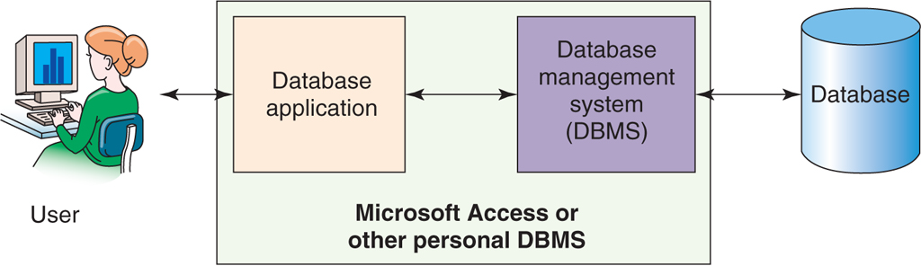
Personal Database Systems
Figure 1-23: Personal Database System

Slide 38
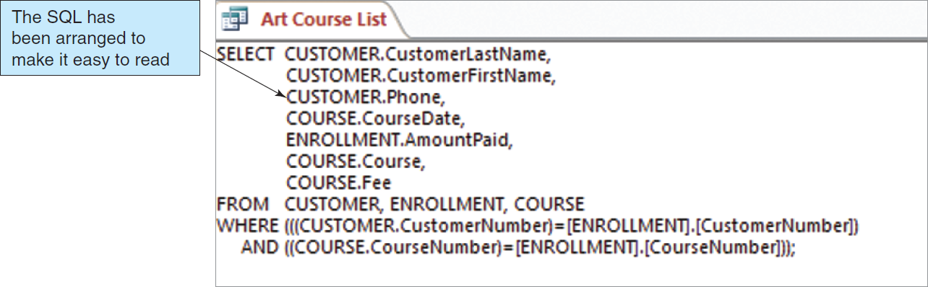
Personal Database Systems: An SQL Query in Microsoft Access
Figure 1-24: SQL Generated by Microsoft Access Query

Slide 39
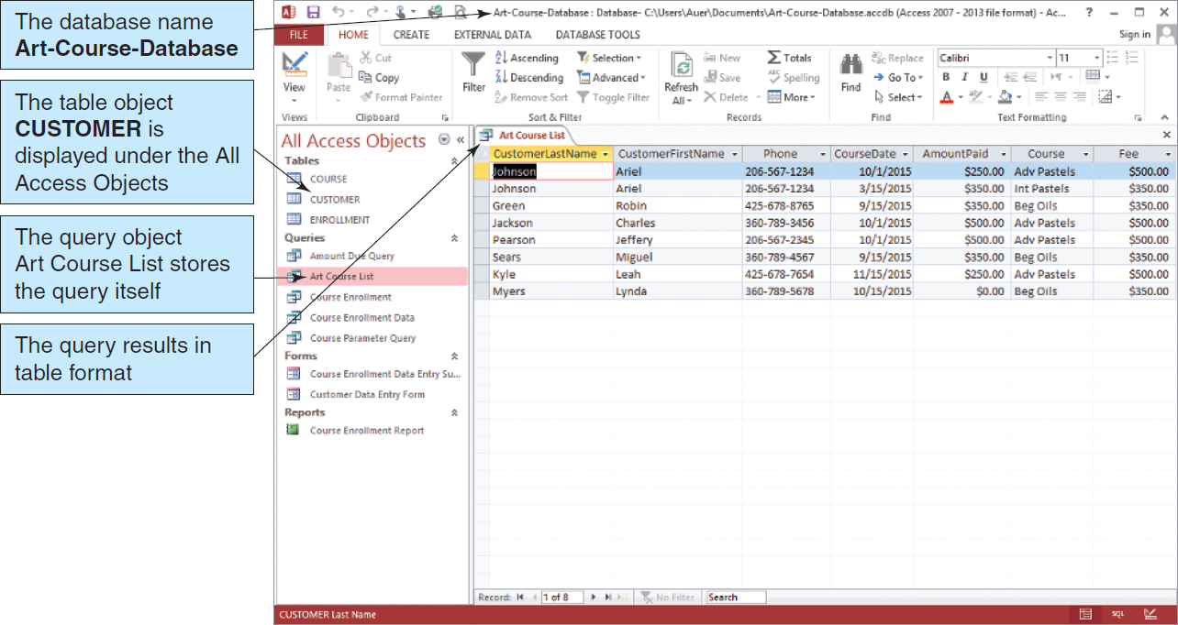
Personal Database Systems: SQL Query Results in Microsoft Access
Figure 1-25: Microsoft Access 2010

Slide 40
Enterprise-Class Database Systems
Enterprise-Class database systems typically:
support several users simultaneously,
include more than one application,
involve multiple computers,
are complex in design,
have many tables, and
have many databases.

Slide 41
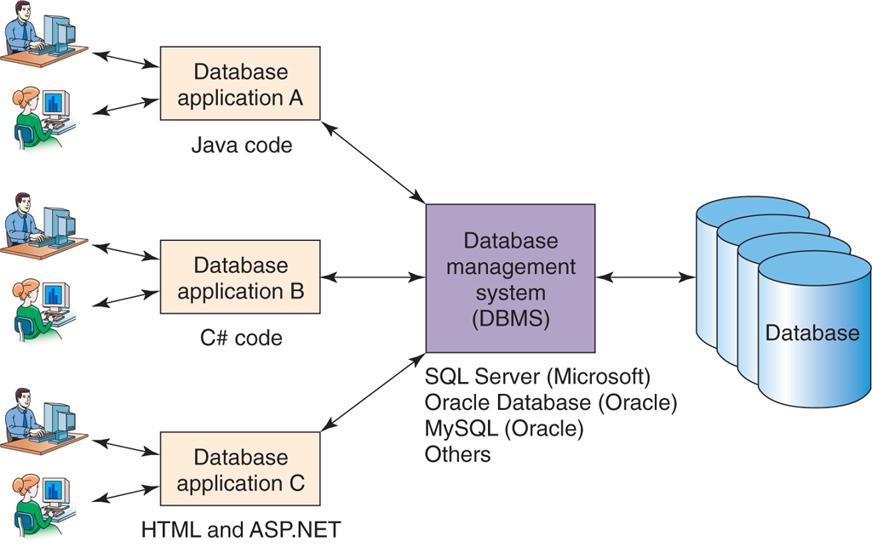
Organizational Database Systems
Figure 1-26 Enterprise-Class Database System

Slide 42
Commercial DBMS Products
Example of Desktop DBMS Products
Microsoft Access
Examples of Organizational DBMS Products
Microsoft’s SQL Server
Oracle’s Oracle
Sun Microsystem’s MySQL
IBM’s DB2
Notes:
Oracle 1.(고대 그리스에서) 신탁을 받는 곳 [신탁을 전하는 사제] 2.(고대 그리스에서) 신탁 3.귀중한 조언을 주는 사람
神託 (신탁) 신이 사람을 매개자로 하여 그의 뜻을 나타내거나 인간의 물음에 대답하는 일.

Slide 43
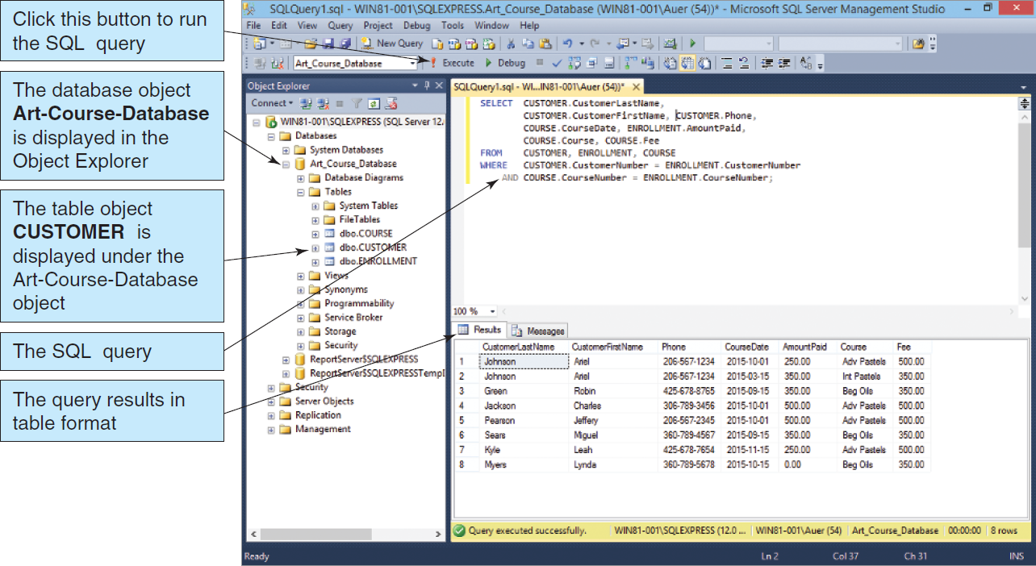
Enterprise-Class Database Systems: Microsoft SQL Server 2014
Figure 1-27 Microsoft SQL Server 2014

Slide 44
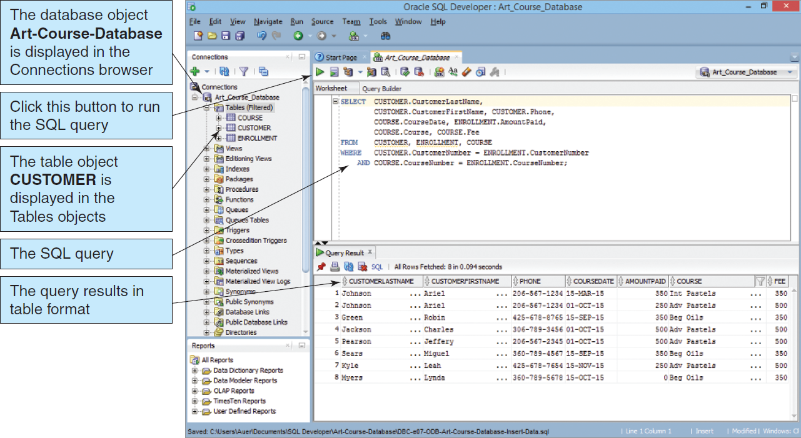
Enterprise-Class Database Systems: Oracle Database Express Edition 11g Release 2
Figure 1-28 Oracle Database Express Edition 11g Release 2

Slide 45
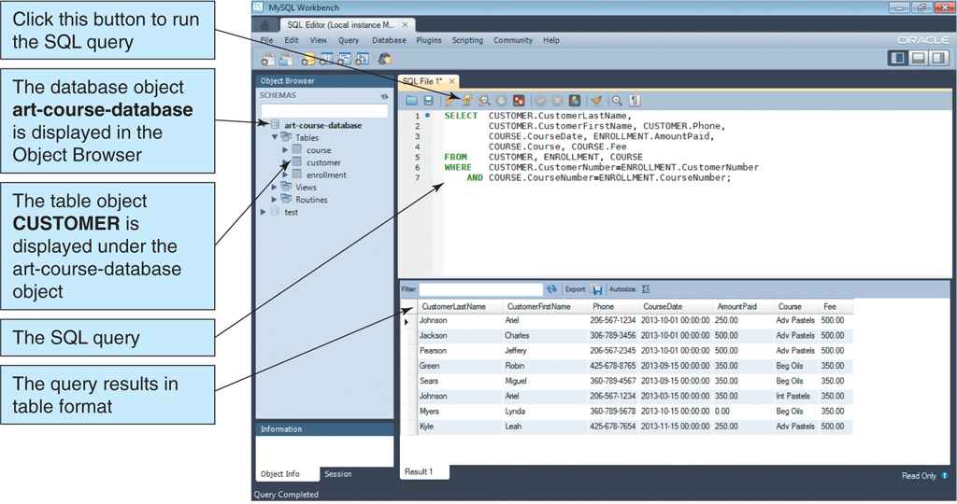
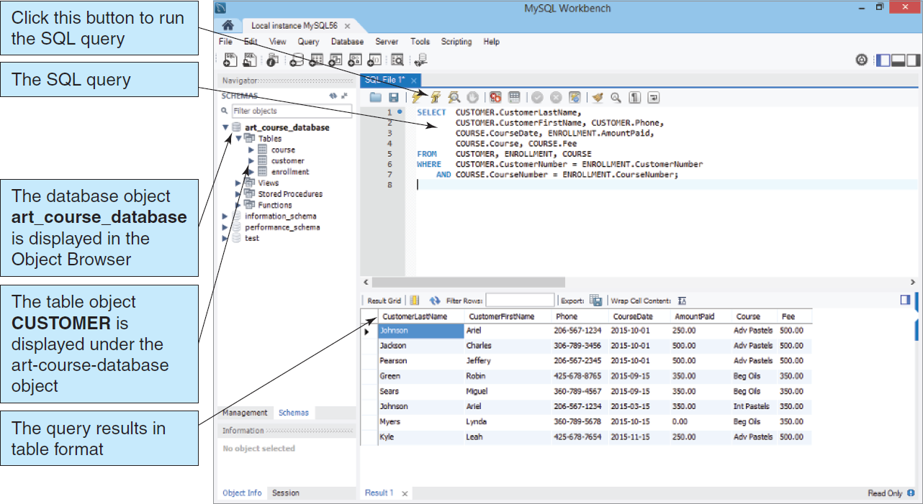
Enterprise-Class Database Systems: MySQL 5.6
Figure 1-29: MySQL 5.6

Slide 46
What is a NoSQL Database?
NoSQL database = Non-relational database
Web 2.0 Applications
Facebook
Twitter
Pinterest
Apache Software Foundation Cassandra
Open source, Distributed, NoSQL
Facebook & Twitter
Notes:
웹 2.0 (Web 2.0)이란 개방, 참여, 공유의 정신을 바탕으로 사용자가 직접 정보를 생산하여 쌍방향으로 소통하는 웹 기술을 말한다. 웹 1.0이 인터넷을 통해 일방적으로 정보를 보여주었다면, 웹 2.0은 사용자가 직접 콘텐츠를 생산하여 쌍방향으로 소통할 수 있다. [위키백과]
Web3 (also known as Web 3.0) is an idea for a new iteration of the World Wide Web which incorporates concepts such as decentralization, blockchain technologies, and token-based economics.
Iteration b.[count noun] a new version of a piece of computer hardware or software. 1.version, incarnation the latest iteration of the operating system
Cassandra [ kəˈsændrə ] 아폴로 신에게서 예지력을 부여 받은 고대 그리스 신화 속의 공주 (Troy 왕 Priam과 Hecuba의 딸) 이름에서 유래. 후에 아폴로 신을 속인 벌로 사람들이 공주를 믿지 않게 됨.

Slide 47
Getting Started: An Overview of Databases
DAVID M. KROENKE and DAVID J. AUER
DATABASE CONCEPTS, 7th Edition, Global Edition
End of Presentation on Chapter One

